Slide 1

JMP Intro For Engineers
J.D. Landgrebe
University of Delaware
Chemical Engineering

Slide 2

Getting Started With JMP® Software
JMP is ideal for reshaping, exploring and analyzing ad hoc data as an engineer
https://www.jmp.com/en_us/home.html
https://www.sas.com/en_us/software/viya.html
Widely used in various industries -- Pharma, Semiconductors, Consumer Goods etc.
Recommended over Excel® and Python for exploratory analysis and visualization
Ease-of-use suited for engineers
Designed with thoughtful combo of statistics and visuals describing data
JMP guides to good statistical practices for non-statisticians

Slide 3
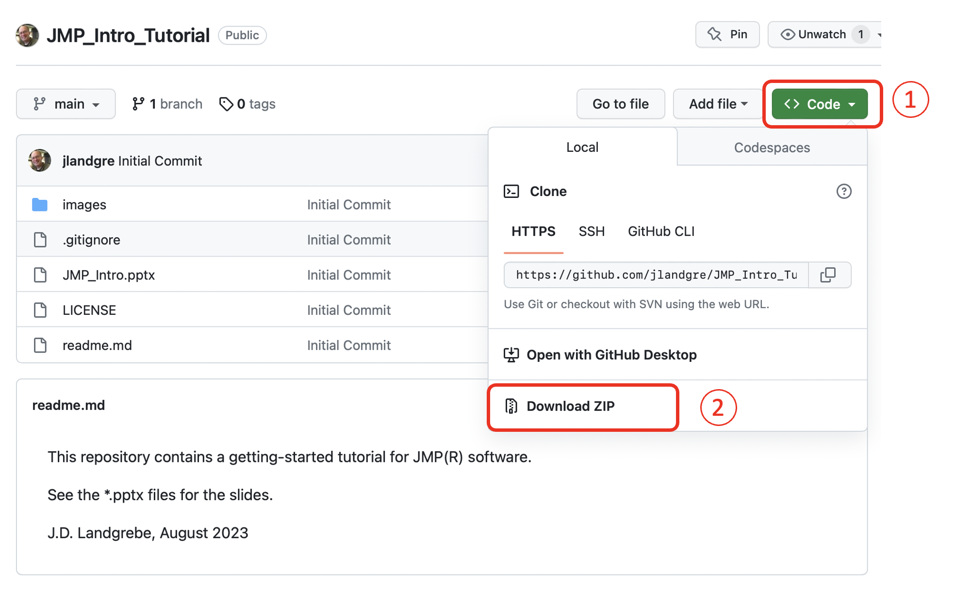
Downloading Tutorial Files
Before starting with JMP, download our tutorial materials from this Github repository: https://github.com/jlandgre/JMP_Intro_Tutorial
Github: Good for engineers to know! It’s common way of sharing open-source materials this training package
Github repositories can be open (like this one) or private

Slide 4
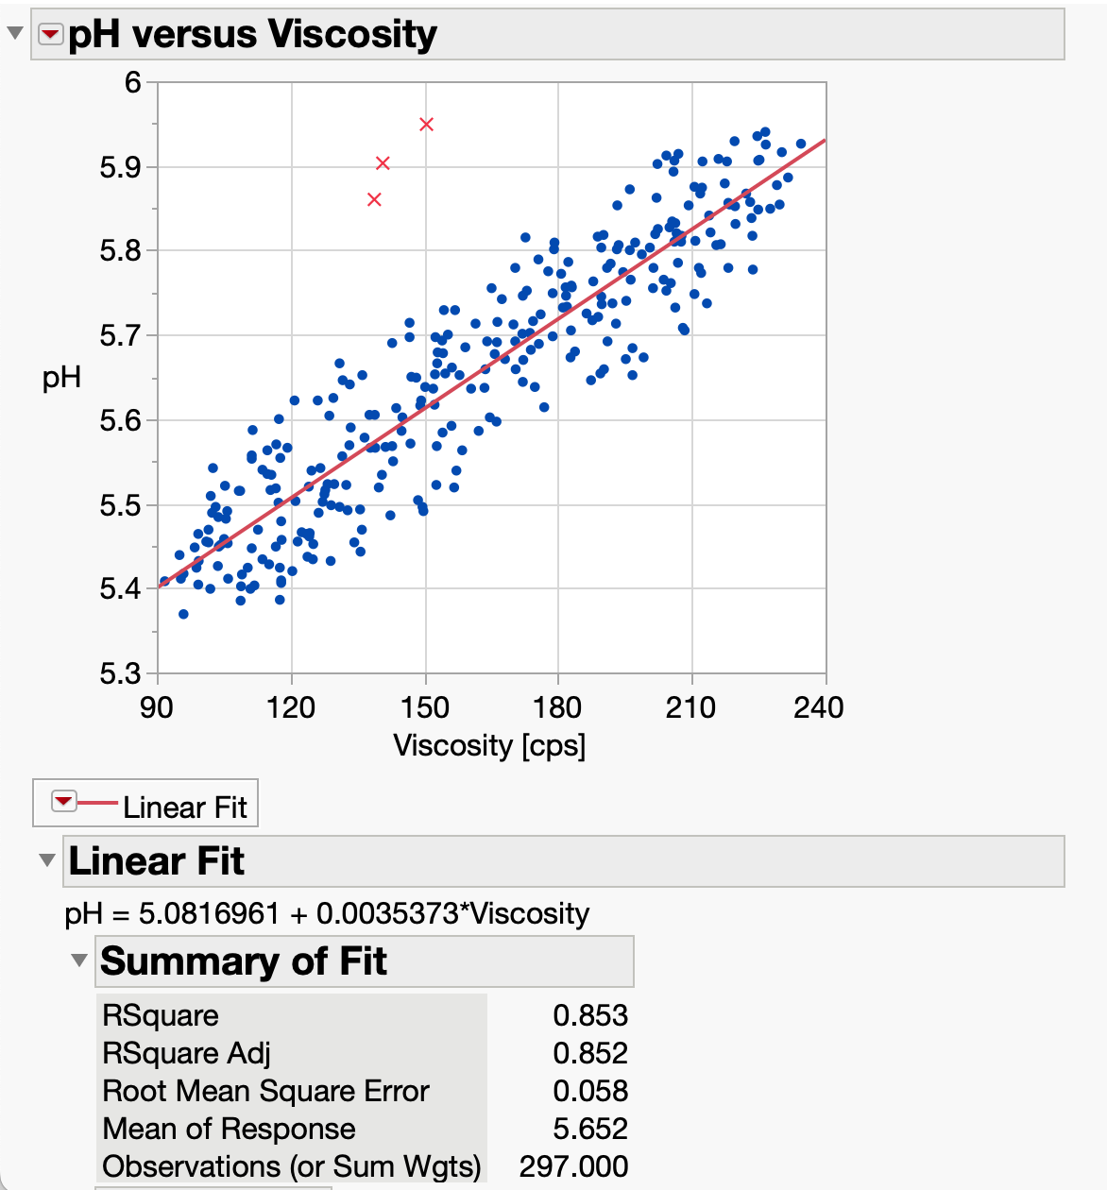
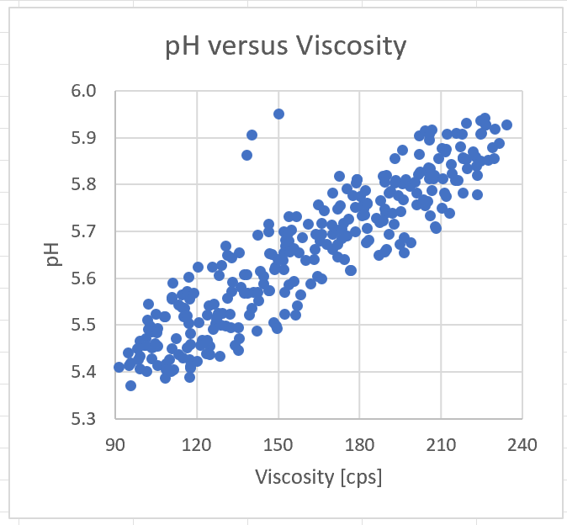
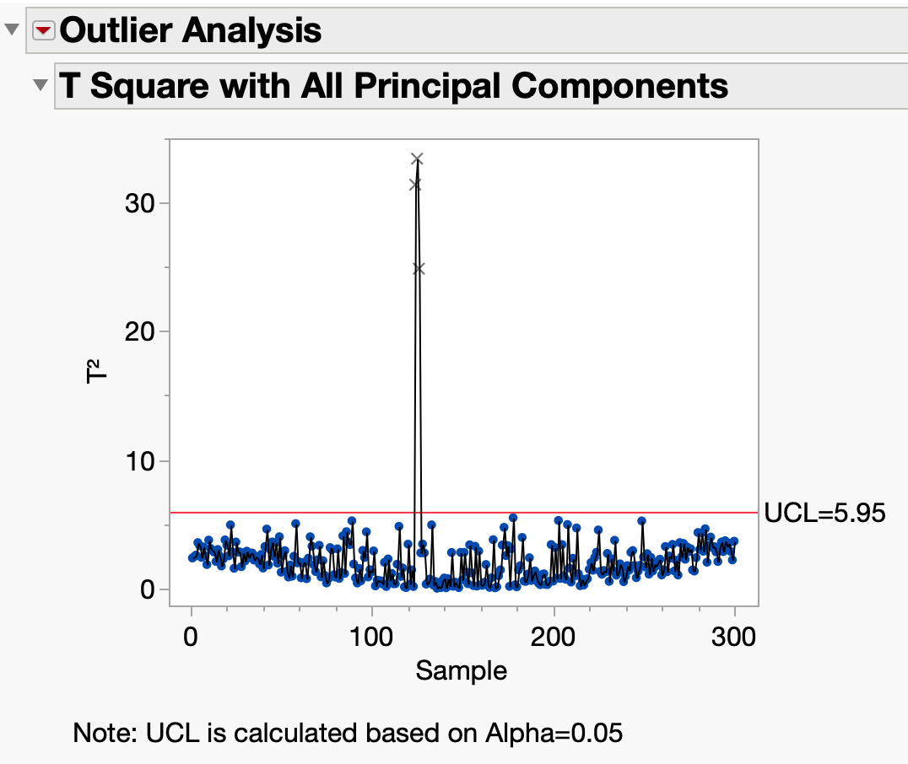
Why JMP?
Linear fit with
outliers excluded
Easy-to-use data reshaping tools
Combine stats and visuals
Guidance on use of stats
Ability to explore subsets of data
Training resources (jmp.com/learn)
MS Excel or Python Plot:
No stats!
Hard to explore fit omitting outliers
[Considerable] stats expertise needed to perform outlier analysis in Python/SciKit Learn
Are outliers abnormal (significant aka p<0.05) combo of pH and viscosity? [Yes!]

Slide 5
JMP Getting Started Topics
This customized tutorial goes with the great (and wide-ranging) tutorials that come with software install. We cover:
Why JMP?
Installation and accessing tutorials that come with the install
Opening files and performing basic analyses
Data selection, Column info and Data Types
Data table operations and reshaping data
Working with variables and basic analyses

Slide 6
Installation
Add U. of Delaware specific instructions

Slide 7
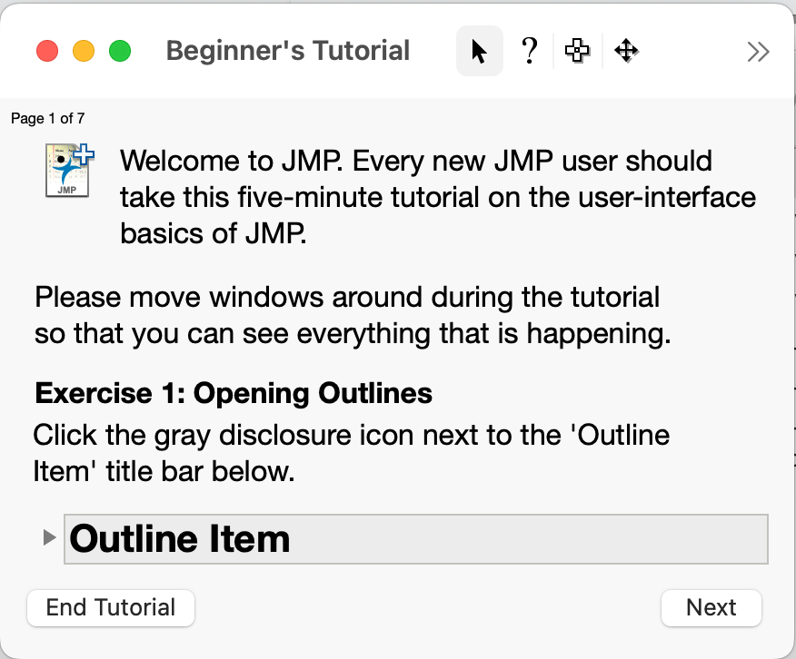
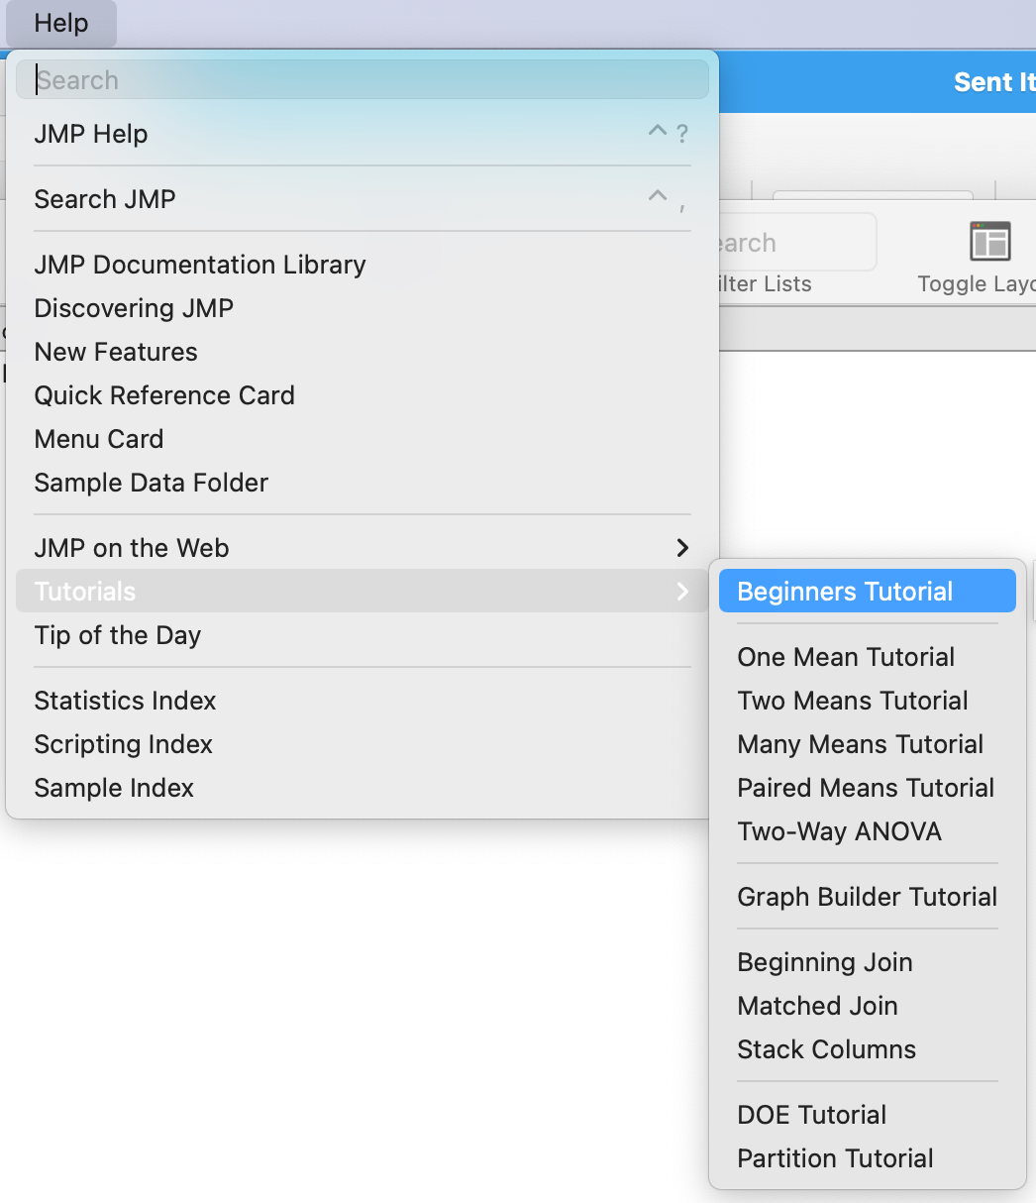
accessing Built-In tutorials
Installation also installs references and resources for learning
As an exercise, launch JMP, choose the Help menu and browse what’s there
Take the 5-minute Beginners Tutorial to get a feel for how JMP works

Slide 8
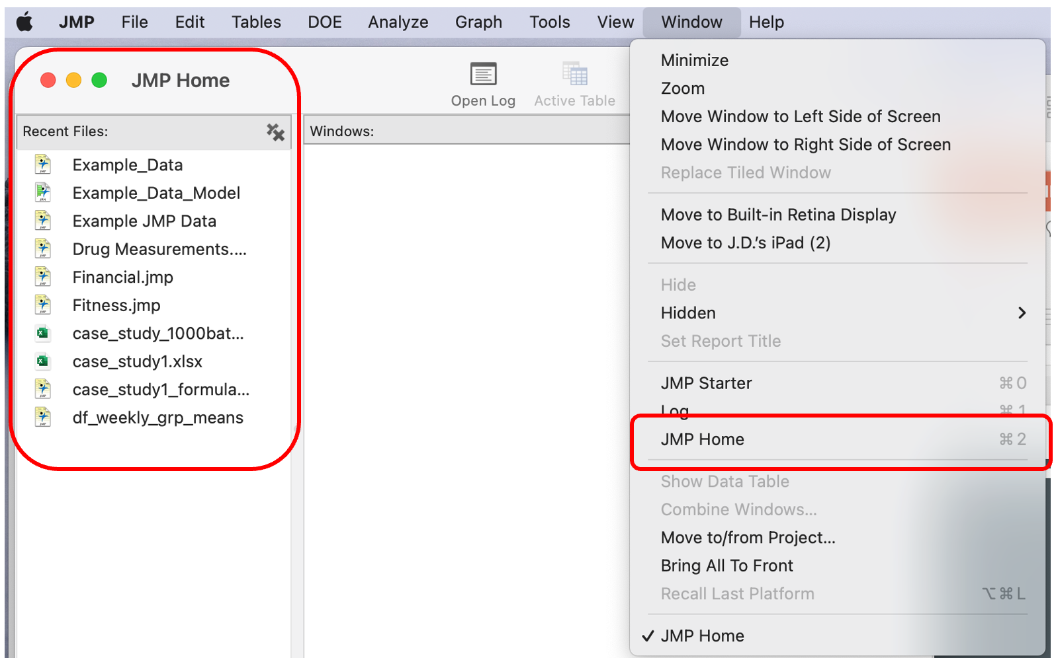
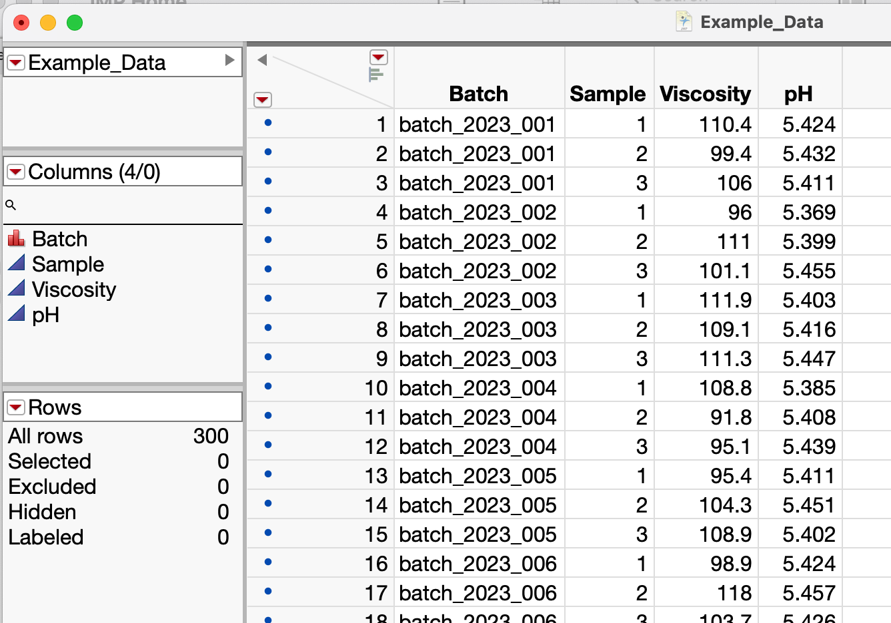
Opening Data Files
JMP can open various formats (*.xlsx, *.csv, Google Sheets etc.)
JMP Home (Window / JMP Home) shows recent files
Exercise: Open the Example_Data.jmp file

Slide 9
Data Table Window
Click here to clear row and column selections
Variable names
Panes contain data table info
Unlike spreadsheet, variable name is not “first row”
Row state summary is helpful especially with large data tables
Nominal (categorical) variable
Continuous (numerical) variables
Row state summary

Slide 10
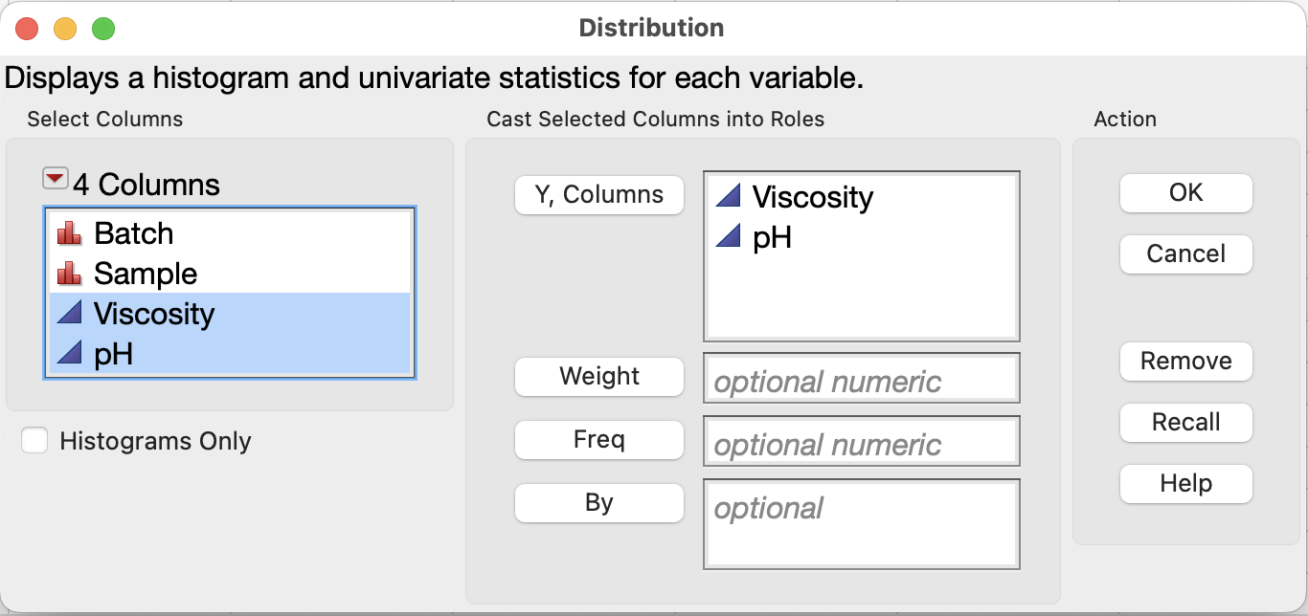
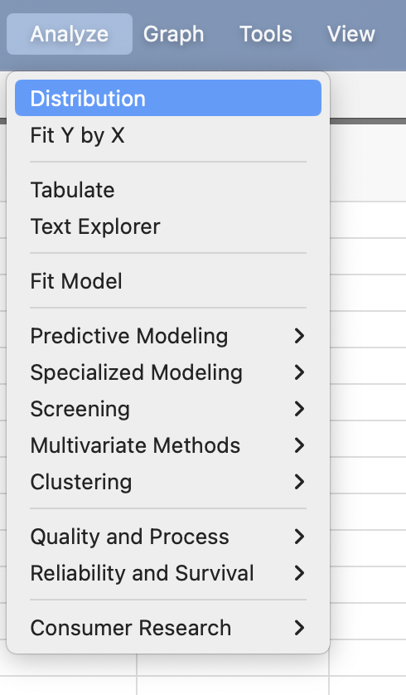
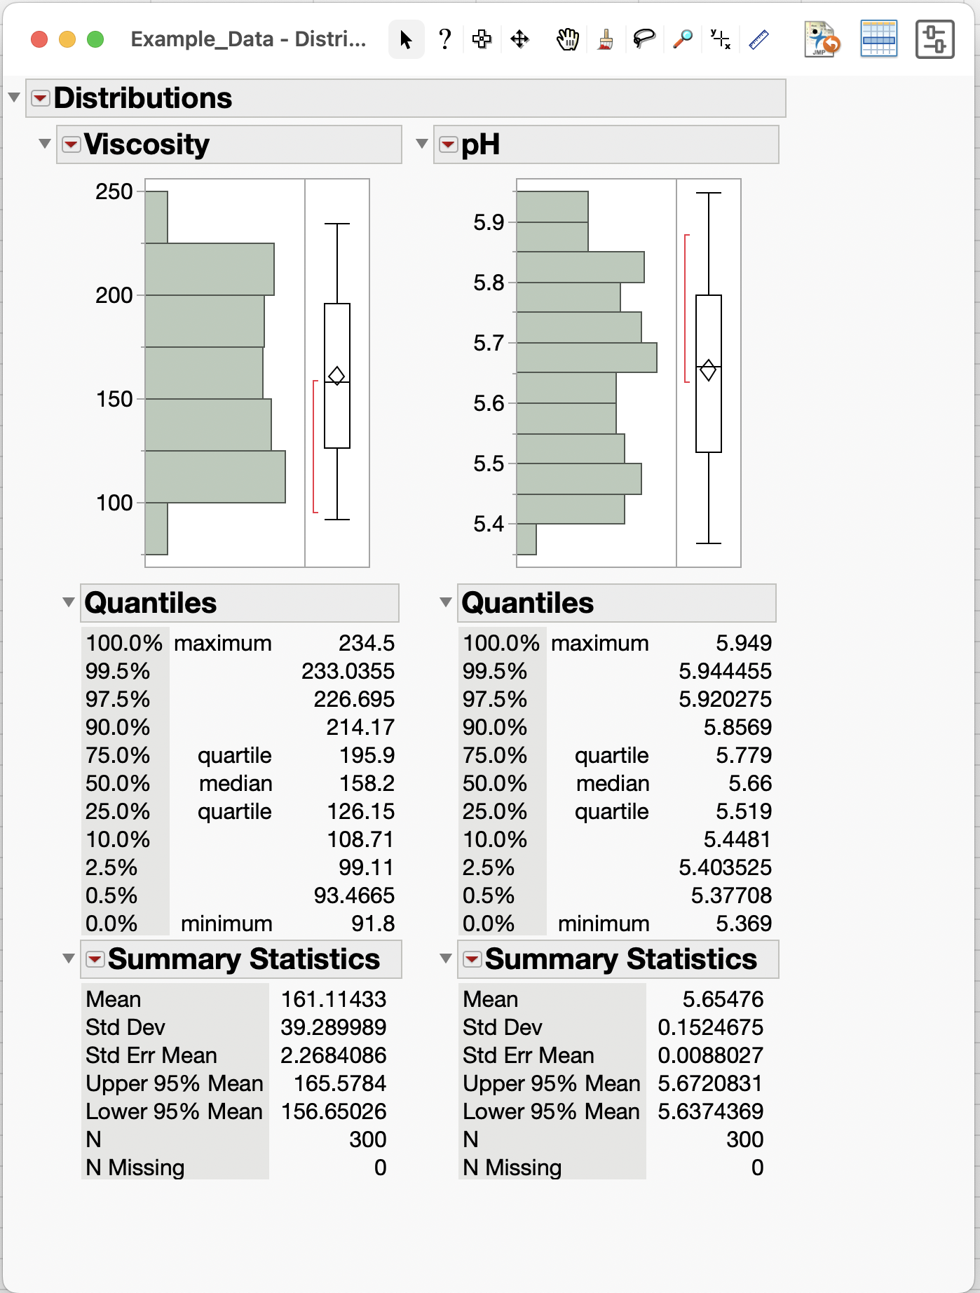
Basic Analyses (Distribution of Data)
1
2
Analyze menu has available analyses
Choose Analyze / Distribution to view distributions and stats for Viscosity and pH data
Drag variables to Y, Columns box and click OK button

Slide 11
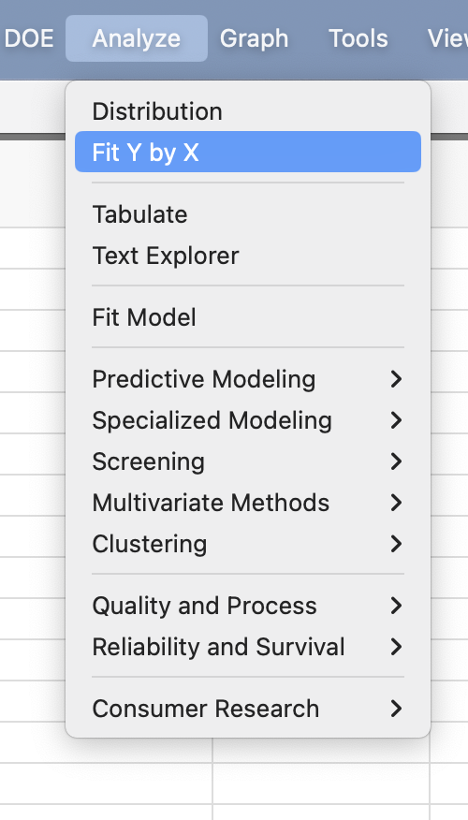
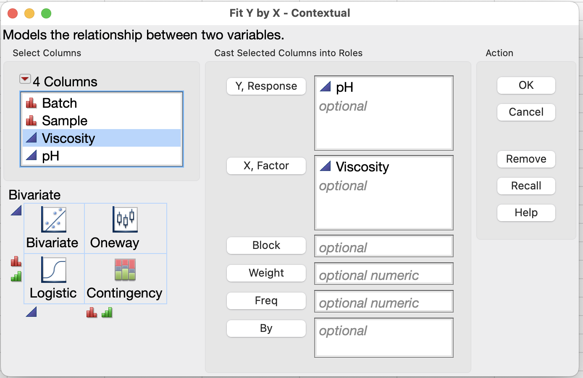
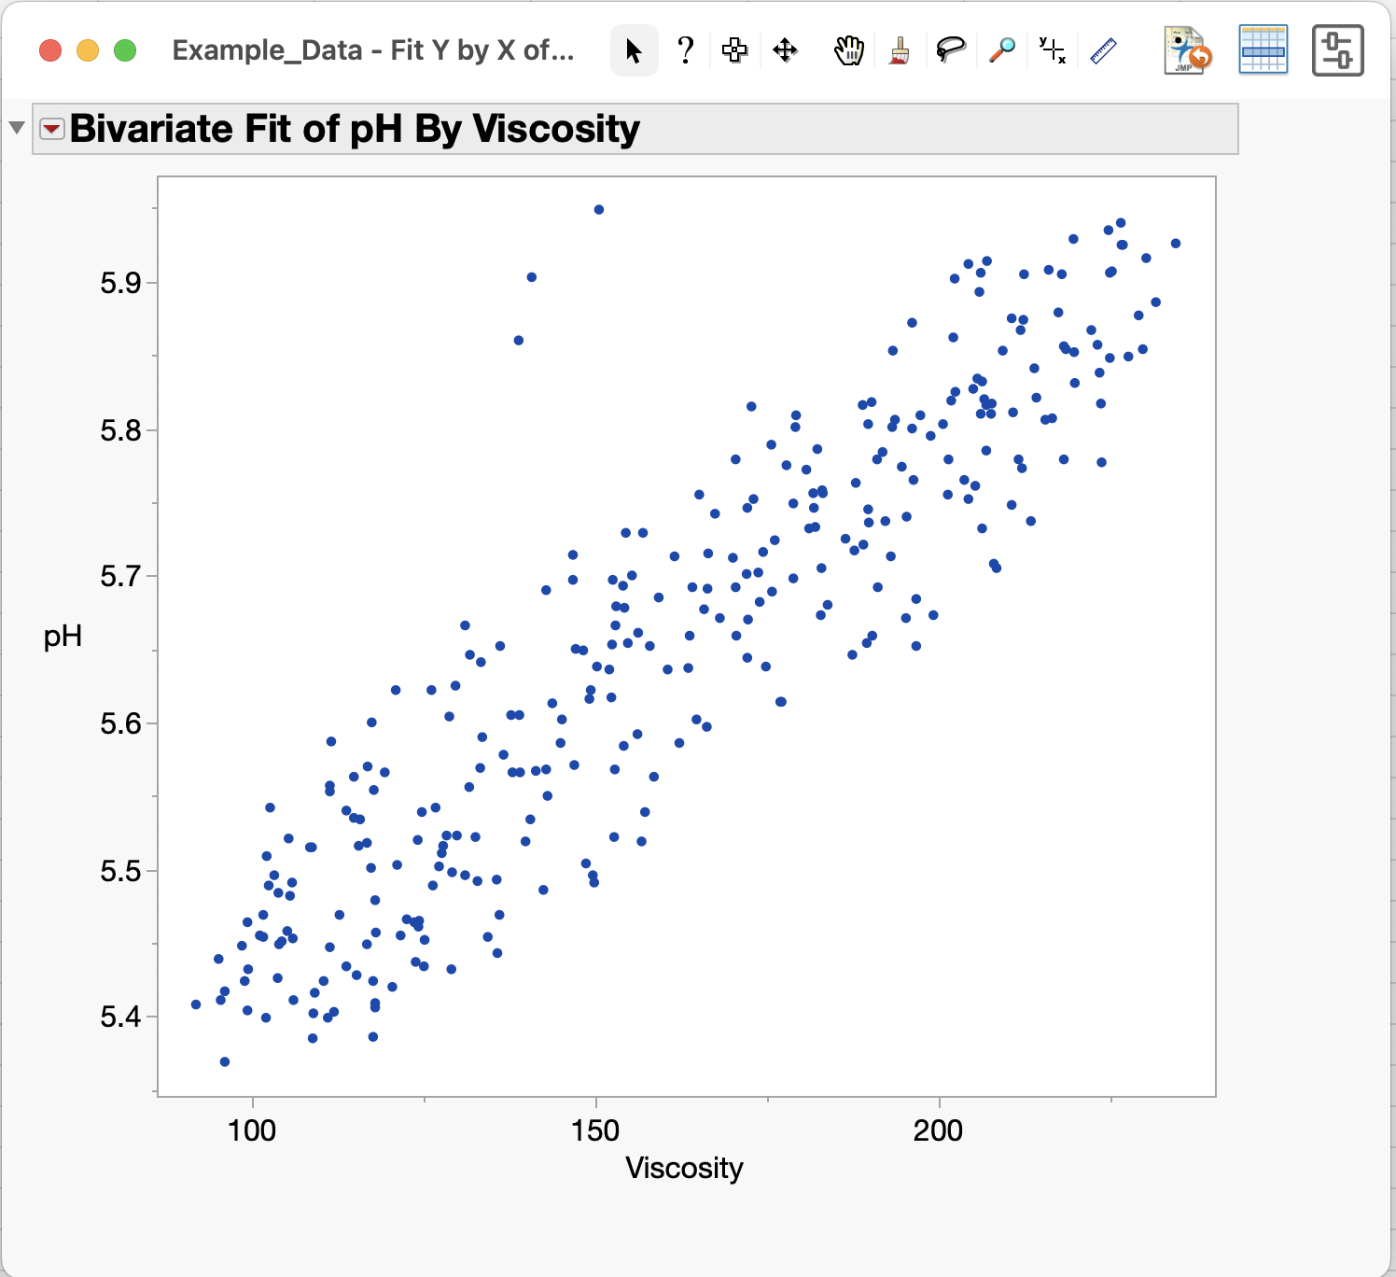
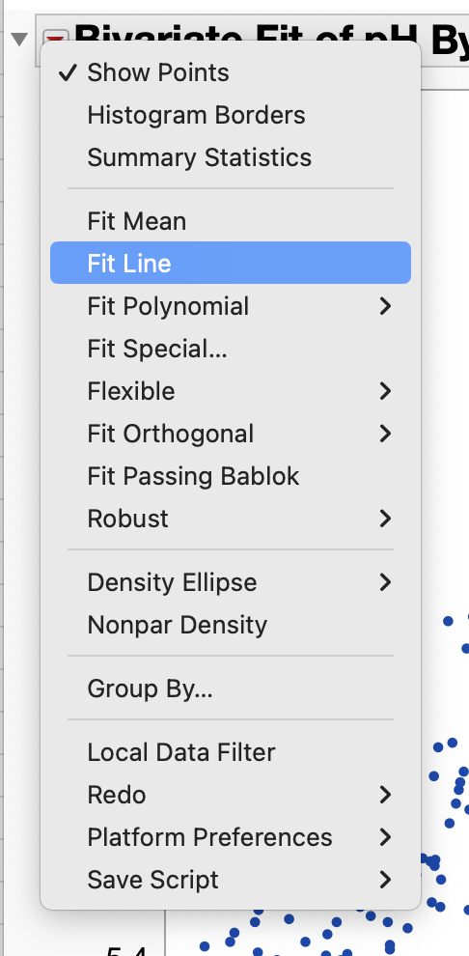
Basic Analyses (Fit Y by X)
2
1
Analyze menu has available analyses
Choose Analyze / Fit Y by X to create a scatterplot with Viscosity and pH data
Red arrow menu has analysis and fitting options
3

Slide 12
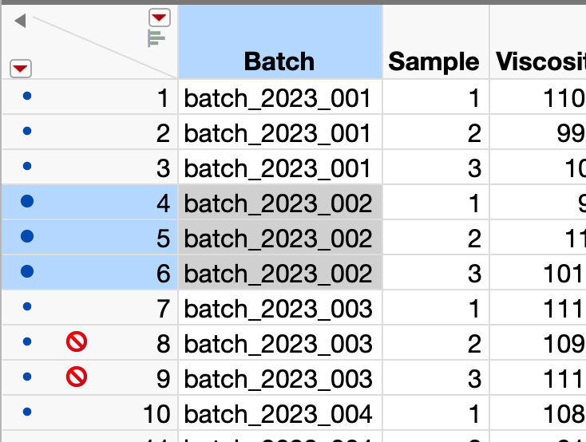
Selecting Data
Click here to clear row and column selections
Click (or shift-Click) to select Column(s)
Can independently select rows and columns
Row State shows how rows are treated on plots and analyses
As an exercise
Copy/paste the three highlighted cells into another application such as a word processor
Select Rows 8 and 9 and use Rows menu to unexcluded them
Click (or shift-Click) to select Row(s)
Excluded rows
Row State info: Color for graphing, Selected status, Excluded status etc.

Slide 13
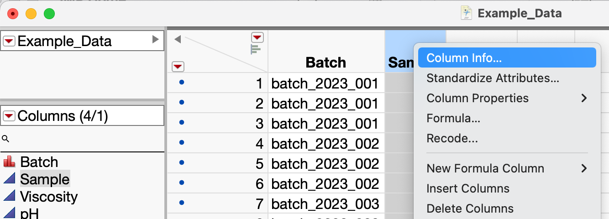
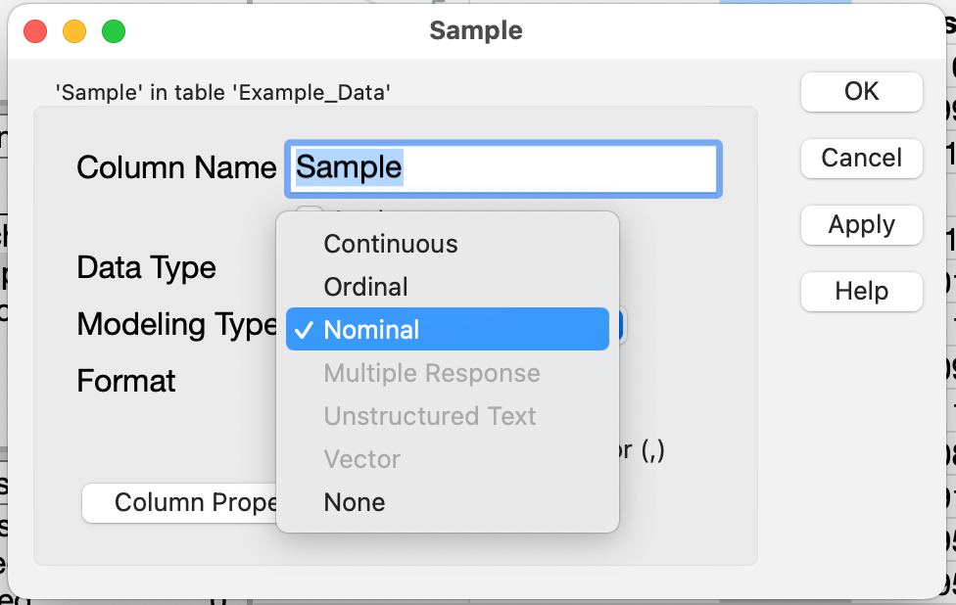
Properties of Variables (Example: Data Type)
Right/Control-Click and choose Column Info
JMP defaults numeric data to be Continuous data type (blue triangle icon)
Sample should be treated as Nominal –it’s a categorical not a numeric
Right-click on Sample column heading and choose Column Info
Select “Nominal” to treat Sample as categorical instead of numeric

Slide 14
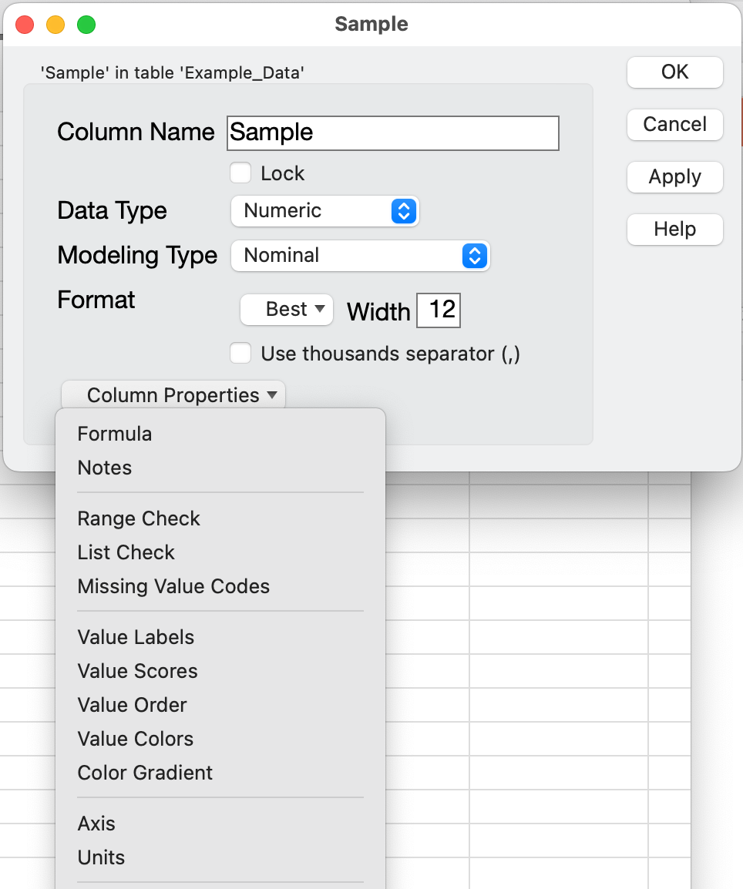
Properties of Variables
In Column Info, Column Properties is a list of metadata you can set
Formula property lets you create calculated variables
Notes and Units properties curate a variable’s description
Value Order controls categorical variable order on plots (e.g. if you want plot order to be “Begin, Middle, End” instead of alphabetical)

